Slide 1

Movie Recommender
Presentation Link
Steve Duncan, Zach Farrar, Mohit Manjaria, Vamshi Munagandla, Sakshi Suri

Slide 2
Background
Zach
The streaming media industry is huge and growing rapidly:
> 200 content providers
Industry market size at $50M and growing at 21% CAGR
> 6,000 movies/series on Netflix alone (> 50,000 individual titles)
Major competitive advantage is recommendation of content to users
Content recommendations need to be:
Relevant
Appropriate
Novel
Diverse

Slide 3
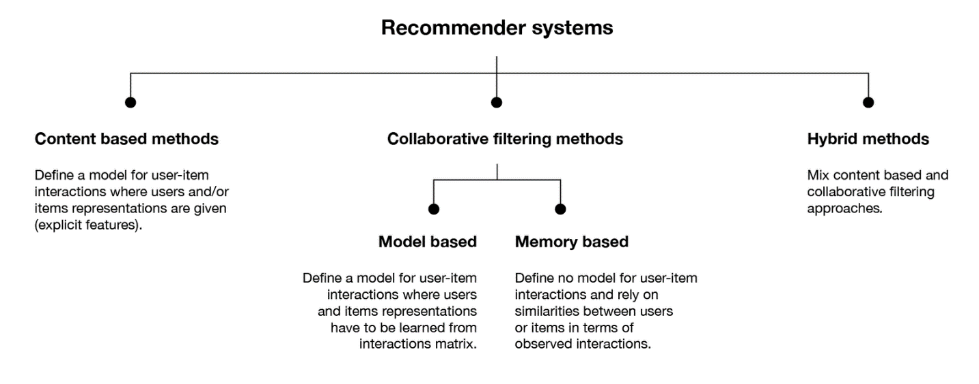
Recommendation Systems – A Primer
Mohit

Slide 4
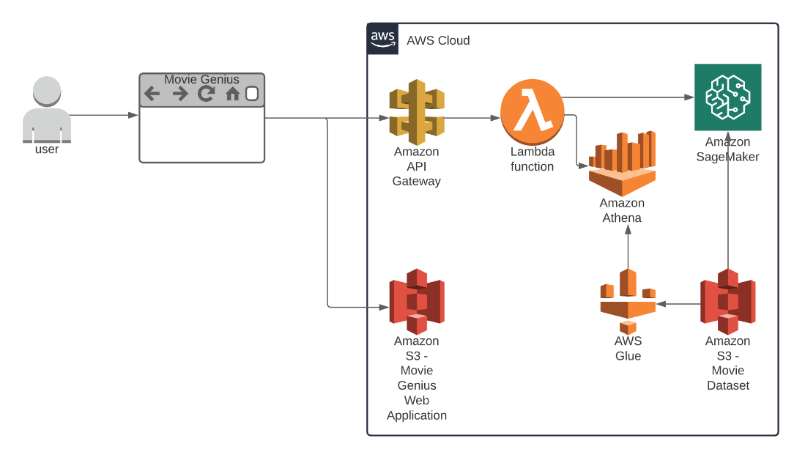
Architecture
Steve, Sakshi, Vamshi, Mohit
Front End:
Static website hosted on S3
Endpoint Interface:
API Gateway
Lambda function:
Interface between front-end and recommender
Transmits requests to Sagemaker
Queries movie dataset on S3 using Athena
SageMaker:
Cosine similarity algorithm - based measurements of two vectors of an inner product space.
Data Storage:
csv data from Kaggle.com and stored in S3
Query Services:
Athena queries supported by AWS Glue

Slide 5
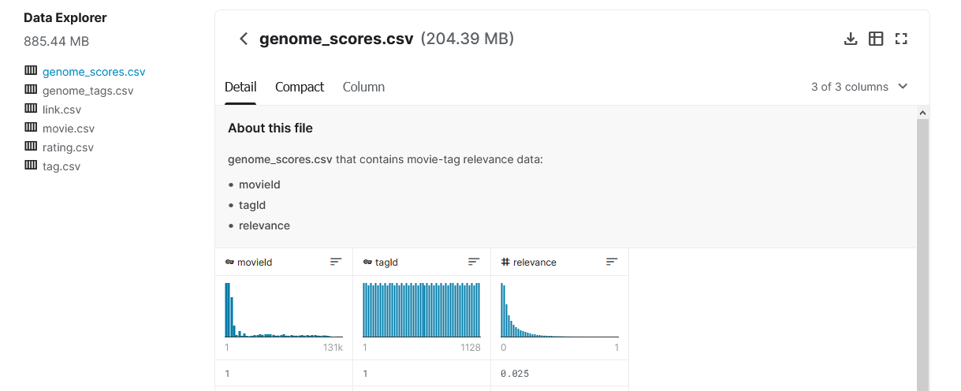
MovieLens 20M Dataset

Slide 6
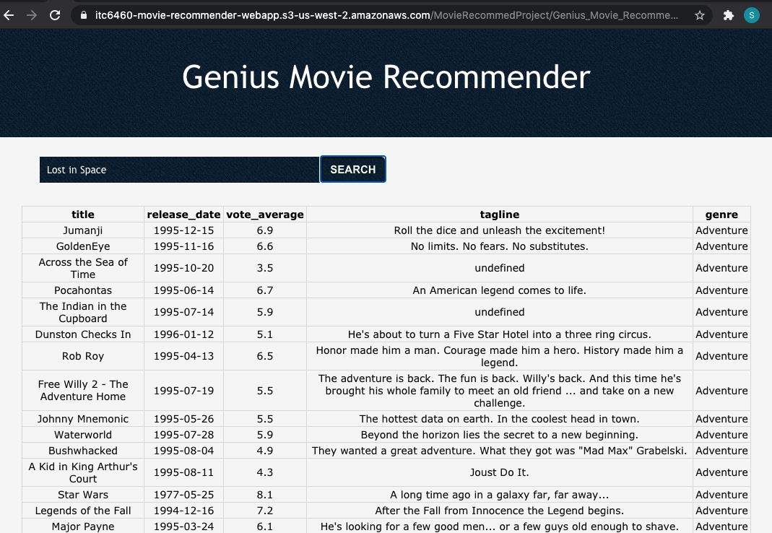
Front End

Slide 7
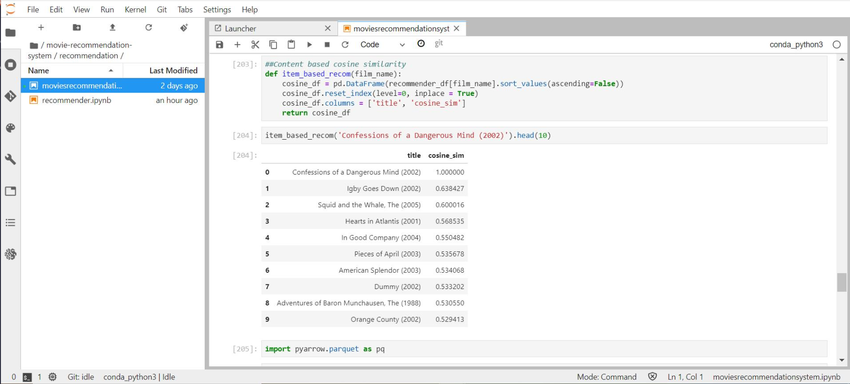
SageMaker Outputs

Slide 8
Product Demo
Model:
Introduce Dataset
Discuss analytic used
Implementation framework
UI:
Show the UI
Highlights of key features
Demo Presentation Link

Slide 9
Conclusion and Next Steps
Zach
Design and development went well
Individual components are less challenging than the integration between components
Serverless architecture reduces design and development workload
More work needed to:
address better integration between front end and back end services,
add movie rating service to gather and store user ratings,
develop 2nd level recommender capabilities leveraging collaborative techniques.
Need to implement security best practices based on AWS Well-Architected Framework

